Slide 1
Preliminary Budget Presentation
Fiscal Year 2018
(July 1, 2017 – June 30, 2018)
DISTRICT GOVERNING BOARD
WORK SESSION
April 26, 2017

Slide 2
Agenda
FY18 Budget Highlights
General Fund
Restricted Fund
Auxiliary Fund
Plant Fund
Retirement of Indebtedness
All Funds Summary
Timeline
State Budget
Truth-in-Taxation Handout

Slide 3
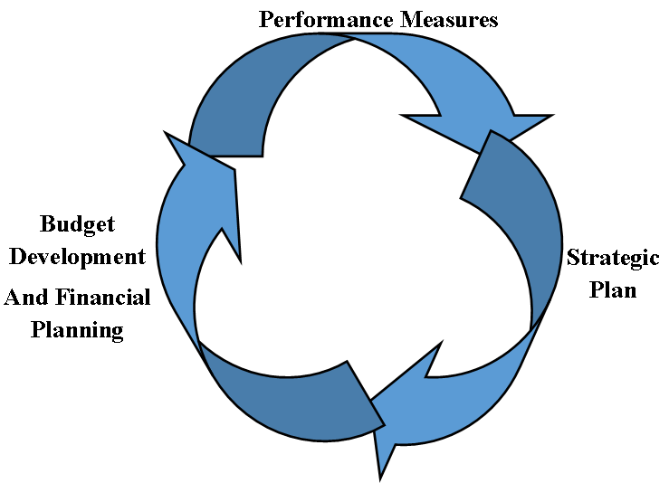
Planning Cycle

Slide 4
2016 Student Progress and Outcomes Report
The 2016-2020 Strategic Plan objectives focus the College’s work on improving the student performance measures listed below.
Retention Measures
7). Developmental Course Success
8). College Level Course Success
9). Reaching Credit Thresholds
10). FA-SP Retention
11). FA-FA Retention
Access Measures
1). Full Time Student Enrollment (FTSE)
2). Enrollment of Underserved Populations
3). Alternative Delivery
4). College-going
5). 1 Yr. Success After Last Developmental Course
6). Cost
Completion Measures
12). Annual Degree/Certificate Completion
13). Transfer Rate
14). Transfer Rate after CCC Completion

Slide 5
Strategic Plan Support
Goal 1: CCC will provide learners educational opportunities that are accessible and affordable, while also being economically feasible for the College.
Dual Enrollment operational increases
Fund Coursework and Programs of Study review
Increase Page academic support
IT minimum wage, Password Manager, and new ITV endpoints
Goal 2: CCC will promote a learner-centered environment that incorporates innovative strategies and support structures intended to reduce student attrition and increase retention.
Increase Library eBook collection
Interim Dean of Learning position made permanent
Fund Aspire EDU Performance Analytics
State Authorization Reciprocity Agreement/State Portal Agency
Higher Learning Commission accreditation travel
Student SafeCampus training
PTK Induction

Slide 6
Strategic Plan Support
Goal 3: CCC will empower students to achieve their individual learning goals and implement strategies to increase certificate and degree completion rates.
Increase full-time faculty (5)
Increase instructional supplies
New faculty orientation
Provost travel for mandatory State Articulation Task Force meetings
Goal 4: CCC will strengthen the College’s working environment by maximizing college resources, expanding community outreach, and implementing effective personnel management and employee development strategies.
Fund Library subscriptions and Consortium
Implement electronic forms
Expand and improve faculty forum
Travel for 3rd Dean of Learning and State Articulation Task Force meetings
Employee training, assistance, and background checks
HLC Evaluation Coordinators

Slide 7
Performance Measures

Slide 8
General Fund

Slide 9
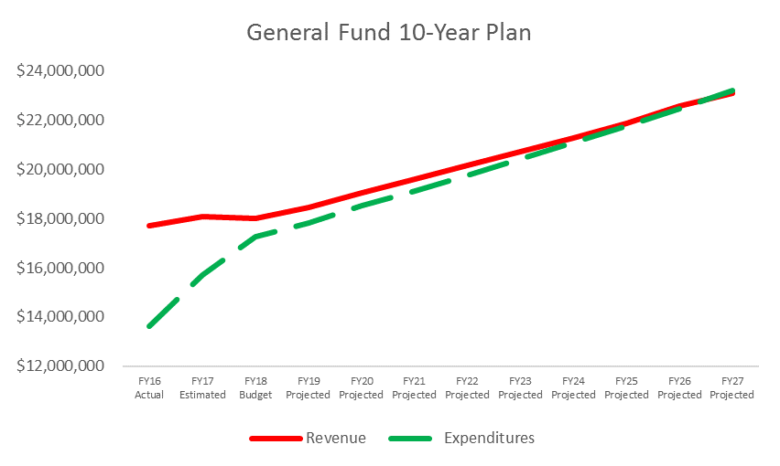
General Fund Projection

Slide 10
General Fund Budget Overview

Slide 11
FY18 General Fund
Revenues

Slide 12
FY18 General Fund Revenues
$18,568,090

Slide 13
FY18 General Fund
Expenditures by Program
Note: $2 Million in Contingency is for emergencies and would come from Fund Balance

Slide 14
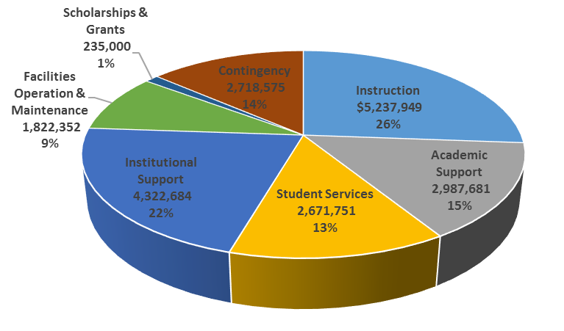
FY18 General Fund
Expenditures by Program
$19,995,992

Slide 15
FY18 Reserves and Contingency

Slide 16
FY18 Restricted Funds
Revenues

Slide 17
FY18 Restricted Funds
Revenues

Slide 18
FY18 Restricted Funds
Expenditures by Program and Object

Slide 19
FY18 Auxiliary Funds
Revenues & Expenditures

Slide 20
FY18 Plant Fund
Revenues & Expenditures

Slide 21
FY18 Plant Fund
Planned Maintenance
Notes:
Total of $131, 375 will be spent out of the General Fund

Slide 22
FY18 Retirement of Indebtedness Fund

Slide 23
FY18 All Funds Revenues

Slide 24
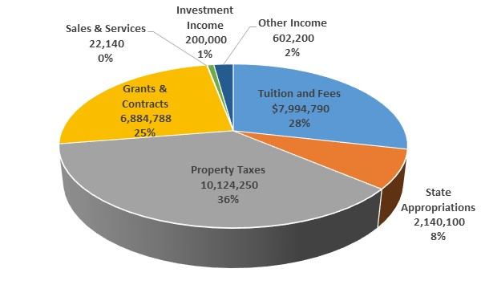
FY18 All Funds Revenues
$27,968,268

Slide 25
FY18 All Funds
Expenditures by Program

Slide 26
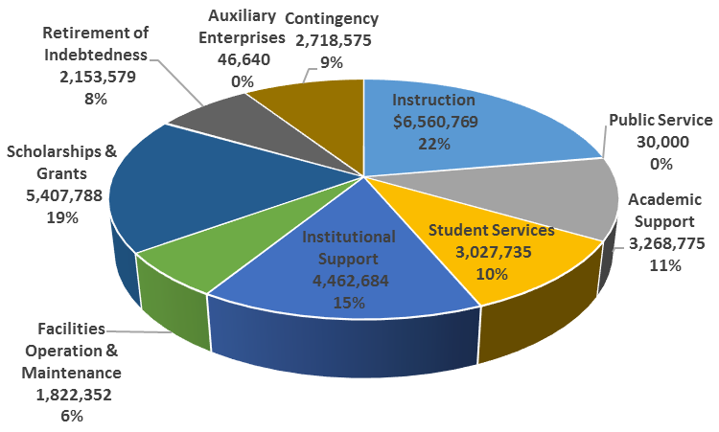
FY18 All Funds
Expenditures by Program
$29,498,797

Slide 27
FY18 All Funds
Expenditures by Object

Slide 28
Timeline
April 26, 2017
  DGB provided with TNT and preliminary budget for review.
May 07, 2017
  First publication of notice for budget (online) and TNT hearings.
May 14, 2017
  Second publication of notice for budget (newspaper) and TNT hearings.
May 24, 2017
  DGB holds TNT hearing, a budget hearing, and a special meeting at which it must adopt the budget for the ensuing fiscal year by roll call vote.

